Slide 1
AUTOMATION PARKING SYSTEM
Progress Report
Week 2
YOLO v5 · Numberplate Detection · ESP32-S3

Slide 2




Progress – Week 2
AUTOMATION PARKING SYSTEM
01
02
Dataset Collection & Labeling
YOLOv5 Model Training
Gathered and annotated car numberplate images for YOLOv5 training
Trained custom YOLOv5 model achieving mAP@0.5 of 0.95
03
04
Model Testing & Inference
ESP32-S3 Integration
Validated detection accuracy and inference speed on test images
Hardware finalized; ESP32-S3 successfully receiving & processing detections

Slide 3
Dataset Collection & Model Training
01 / 02 · Progress – Week 2
Training Outcome
Dataset Preparation
Source: Car numberplate images Labeling: Manual annotation (bounding boxes) Format: YOLO txt label format Split: Train / Validation / Test sets Model: YOLOv5 (custom trained)
0.95
mAP @ 0.5 (Primary Metric)
Training completed successfully with
high detection accuracy on numberplates.
Model is ready for integration and deployment.

Slide 4
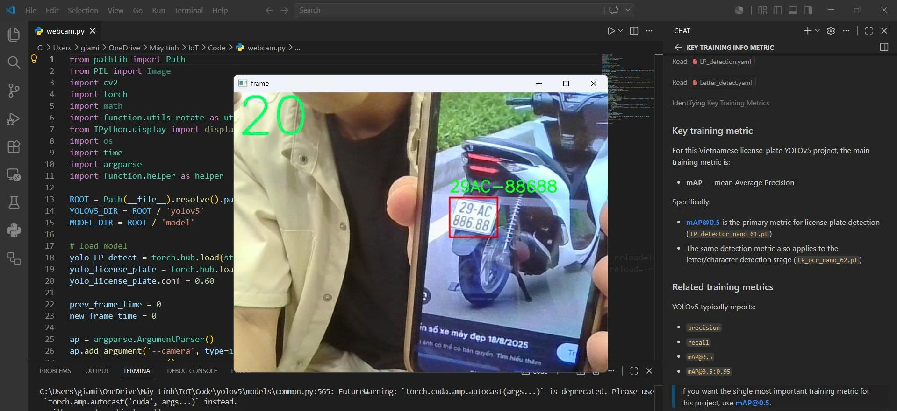

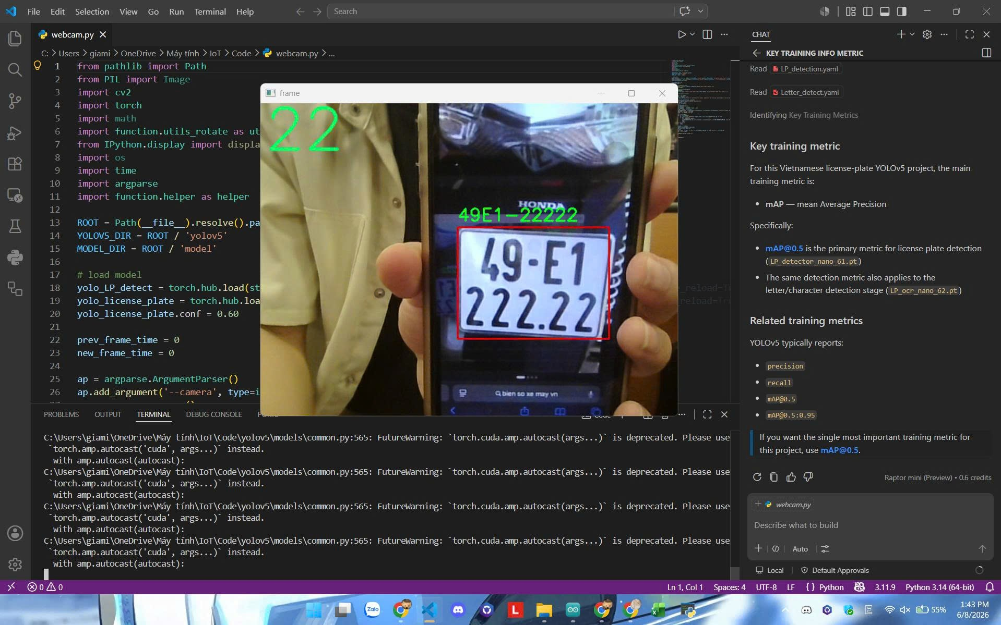
Model Testing & Inference
02 / 02 · Progress – Week 2
Detection Performance
Detects car numberplates accurately under varied conditions
Inference runs on Python backend connected via MQTT
Bounding box output fed to SQLite log database
Results validated against held-out test set

Slide 5
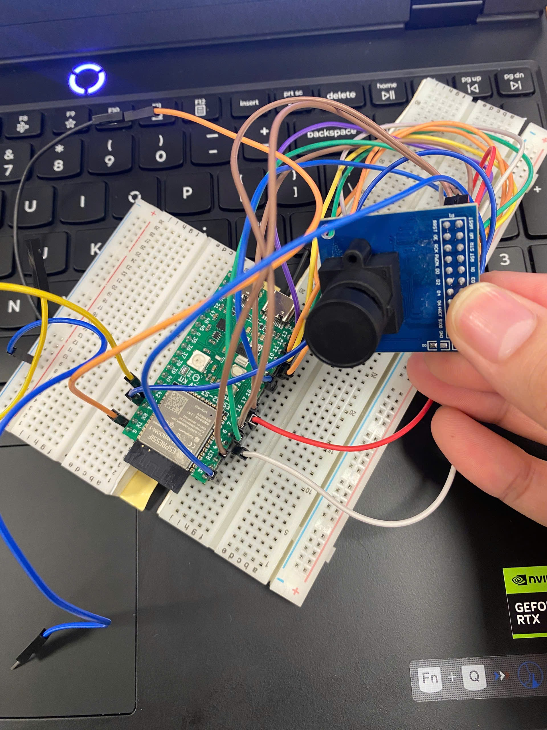
Hardware Integration – ESP32-S3
Progress – Week 2
Hardware: Finalized
Mainboard
ESP32-S3 DevKit
Camera
OV7670 (with FIFO)
Comms
MQTT Broker (Wi-Fi)
Data
[In README file]
Backend
Python inference & logic

Slide 6
Plans for Week 3
AUTOMATION PARKING SYSTEM · UPCOMING
01
02
03
Motion Sensor Firmware
Backend & Firmware Integration
Debugging & Stabilisation
Select & integrate motion sensor module with ESP32-S3
Connect firmware event pipeline to Python backend
Identify and fix timing/sync issues in firmware ↔ backend
Write firmware driver for motion detection events
Validate end-to-end flow: motion → capture → YOLO → log
Run stress tests with repeated detection cycles
Trigger camera capture on motion detection
Debug MQTT message handling between device & server
Review logs and validate data integrity in SQLite
Test sensor sensitivity and response timing
Ensure SQLite records are written reliably on each event

Slide 7
Week 2 : Complete
YOLOv5 trained · mAP@0.5 = 0.95 · Hardware finalized · Integration live
AUTOMATION PARKING SYSTEM · PROGRESS REPORT · WEEK 2

